Slide 1


Notes:
Intro to the Series: Who am I?

Slide 2
Behold our God

Slide 3

Notes:
Intro to theme: I am made by God

Slide 4

I am… wonderfully made
Genesis 1:26-27: ‘Then God said, “Let us make mankind in our image, in our likeness”… So God created mankind in His own image, in the image of God He created them; male and female He created them.’
Psalm 139:13-14: ‘For you created my inmost being; you knit me together in my mother’s womb. I praise you because I am fearfully and wonderfully made; your works are wonderful, I know that full well.’

Slide 6
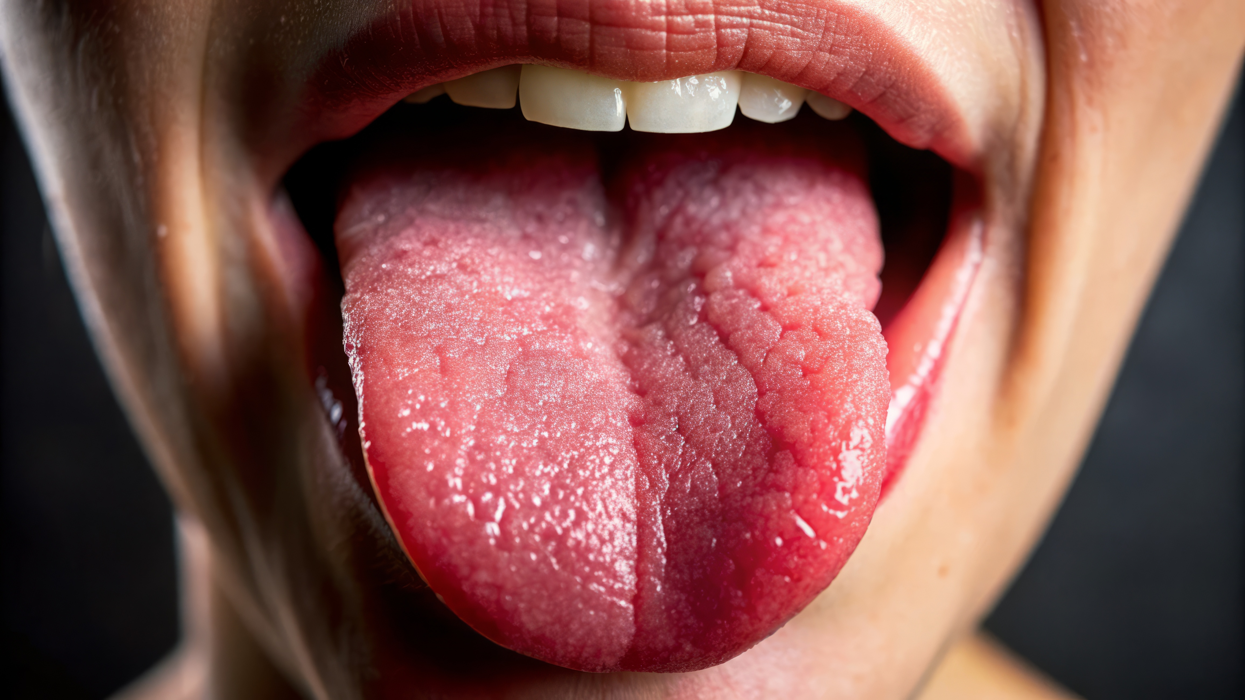

Slide 7
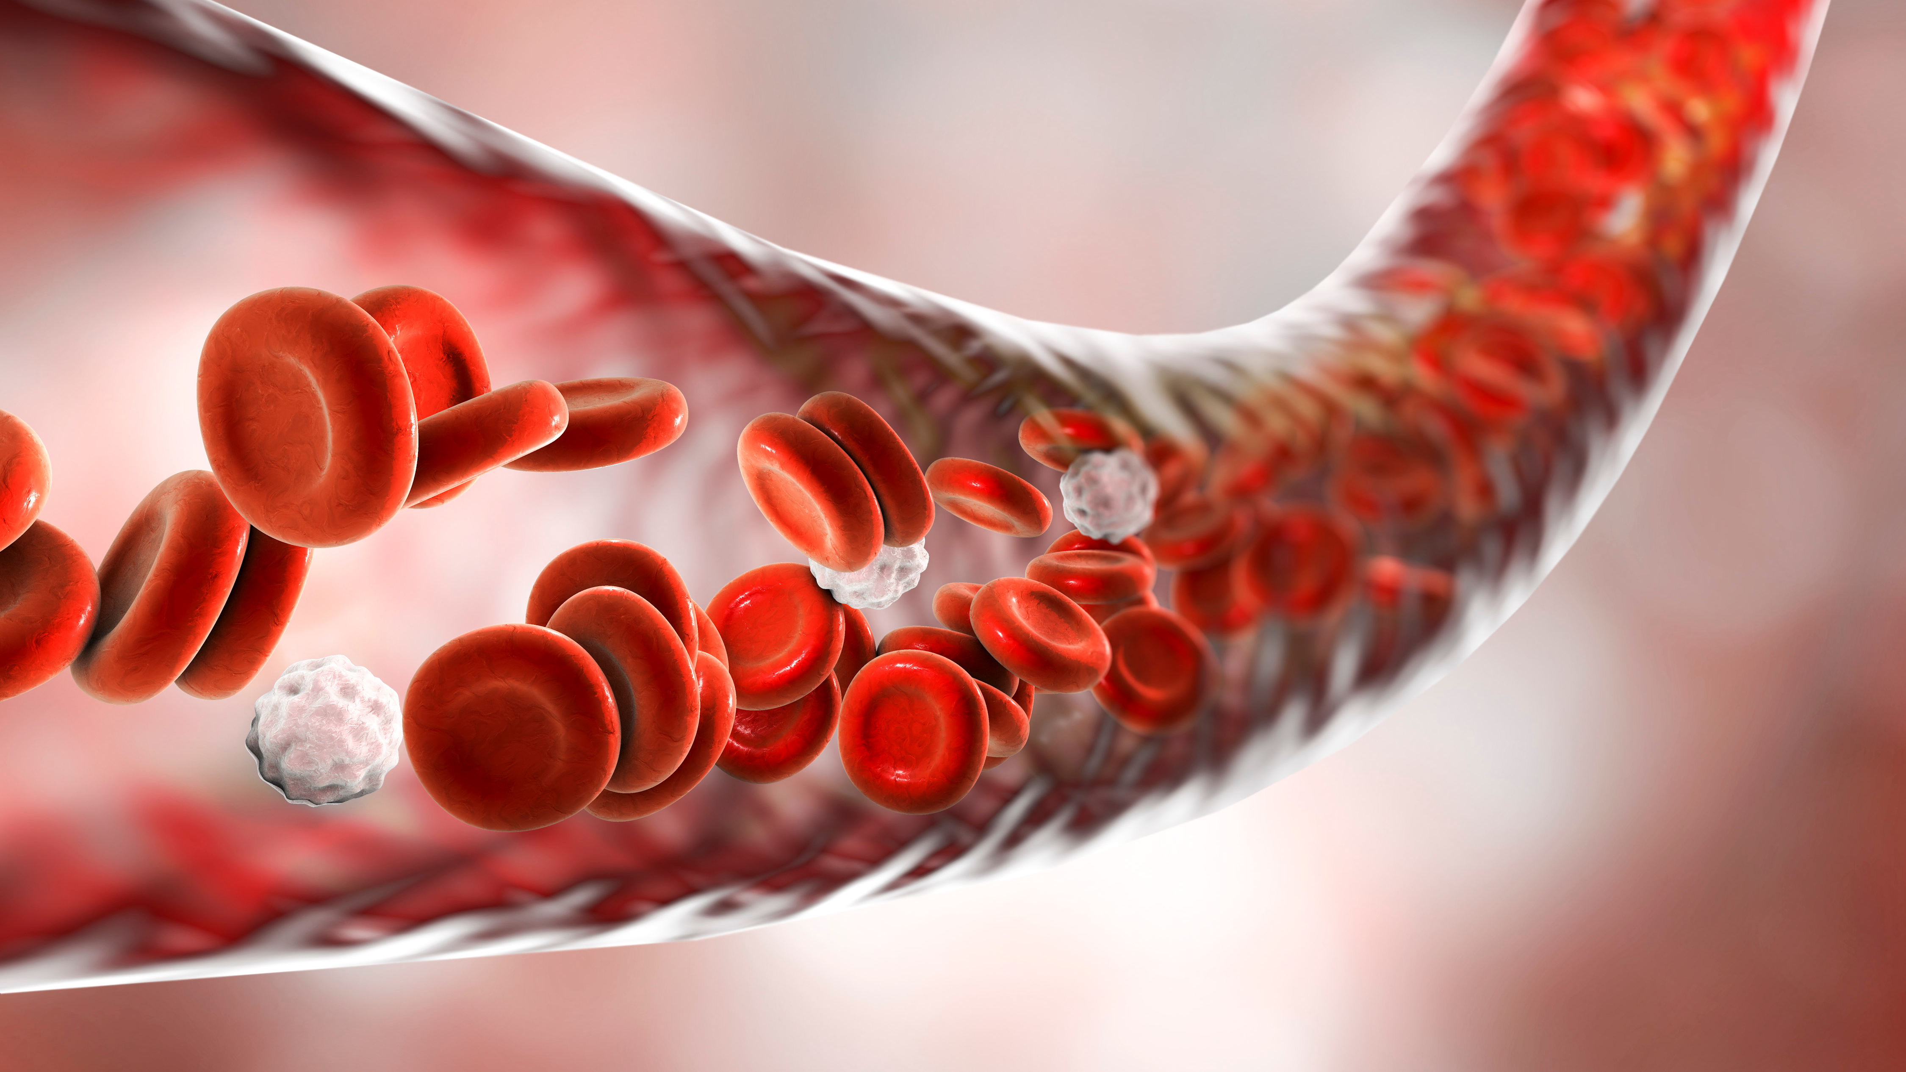

Slide 8
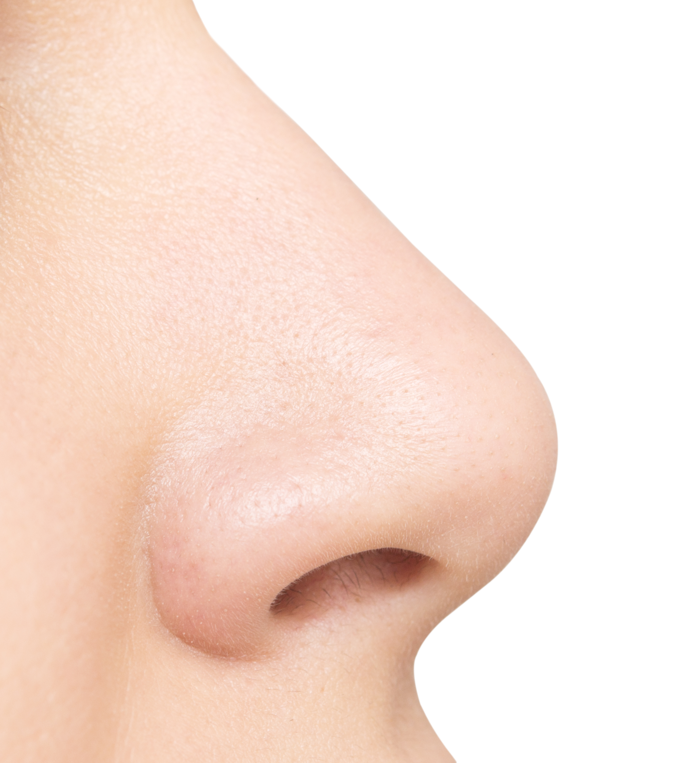

Slide 9
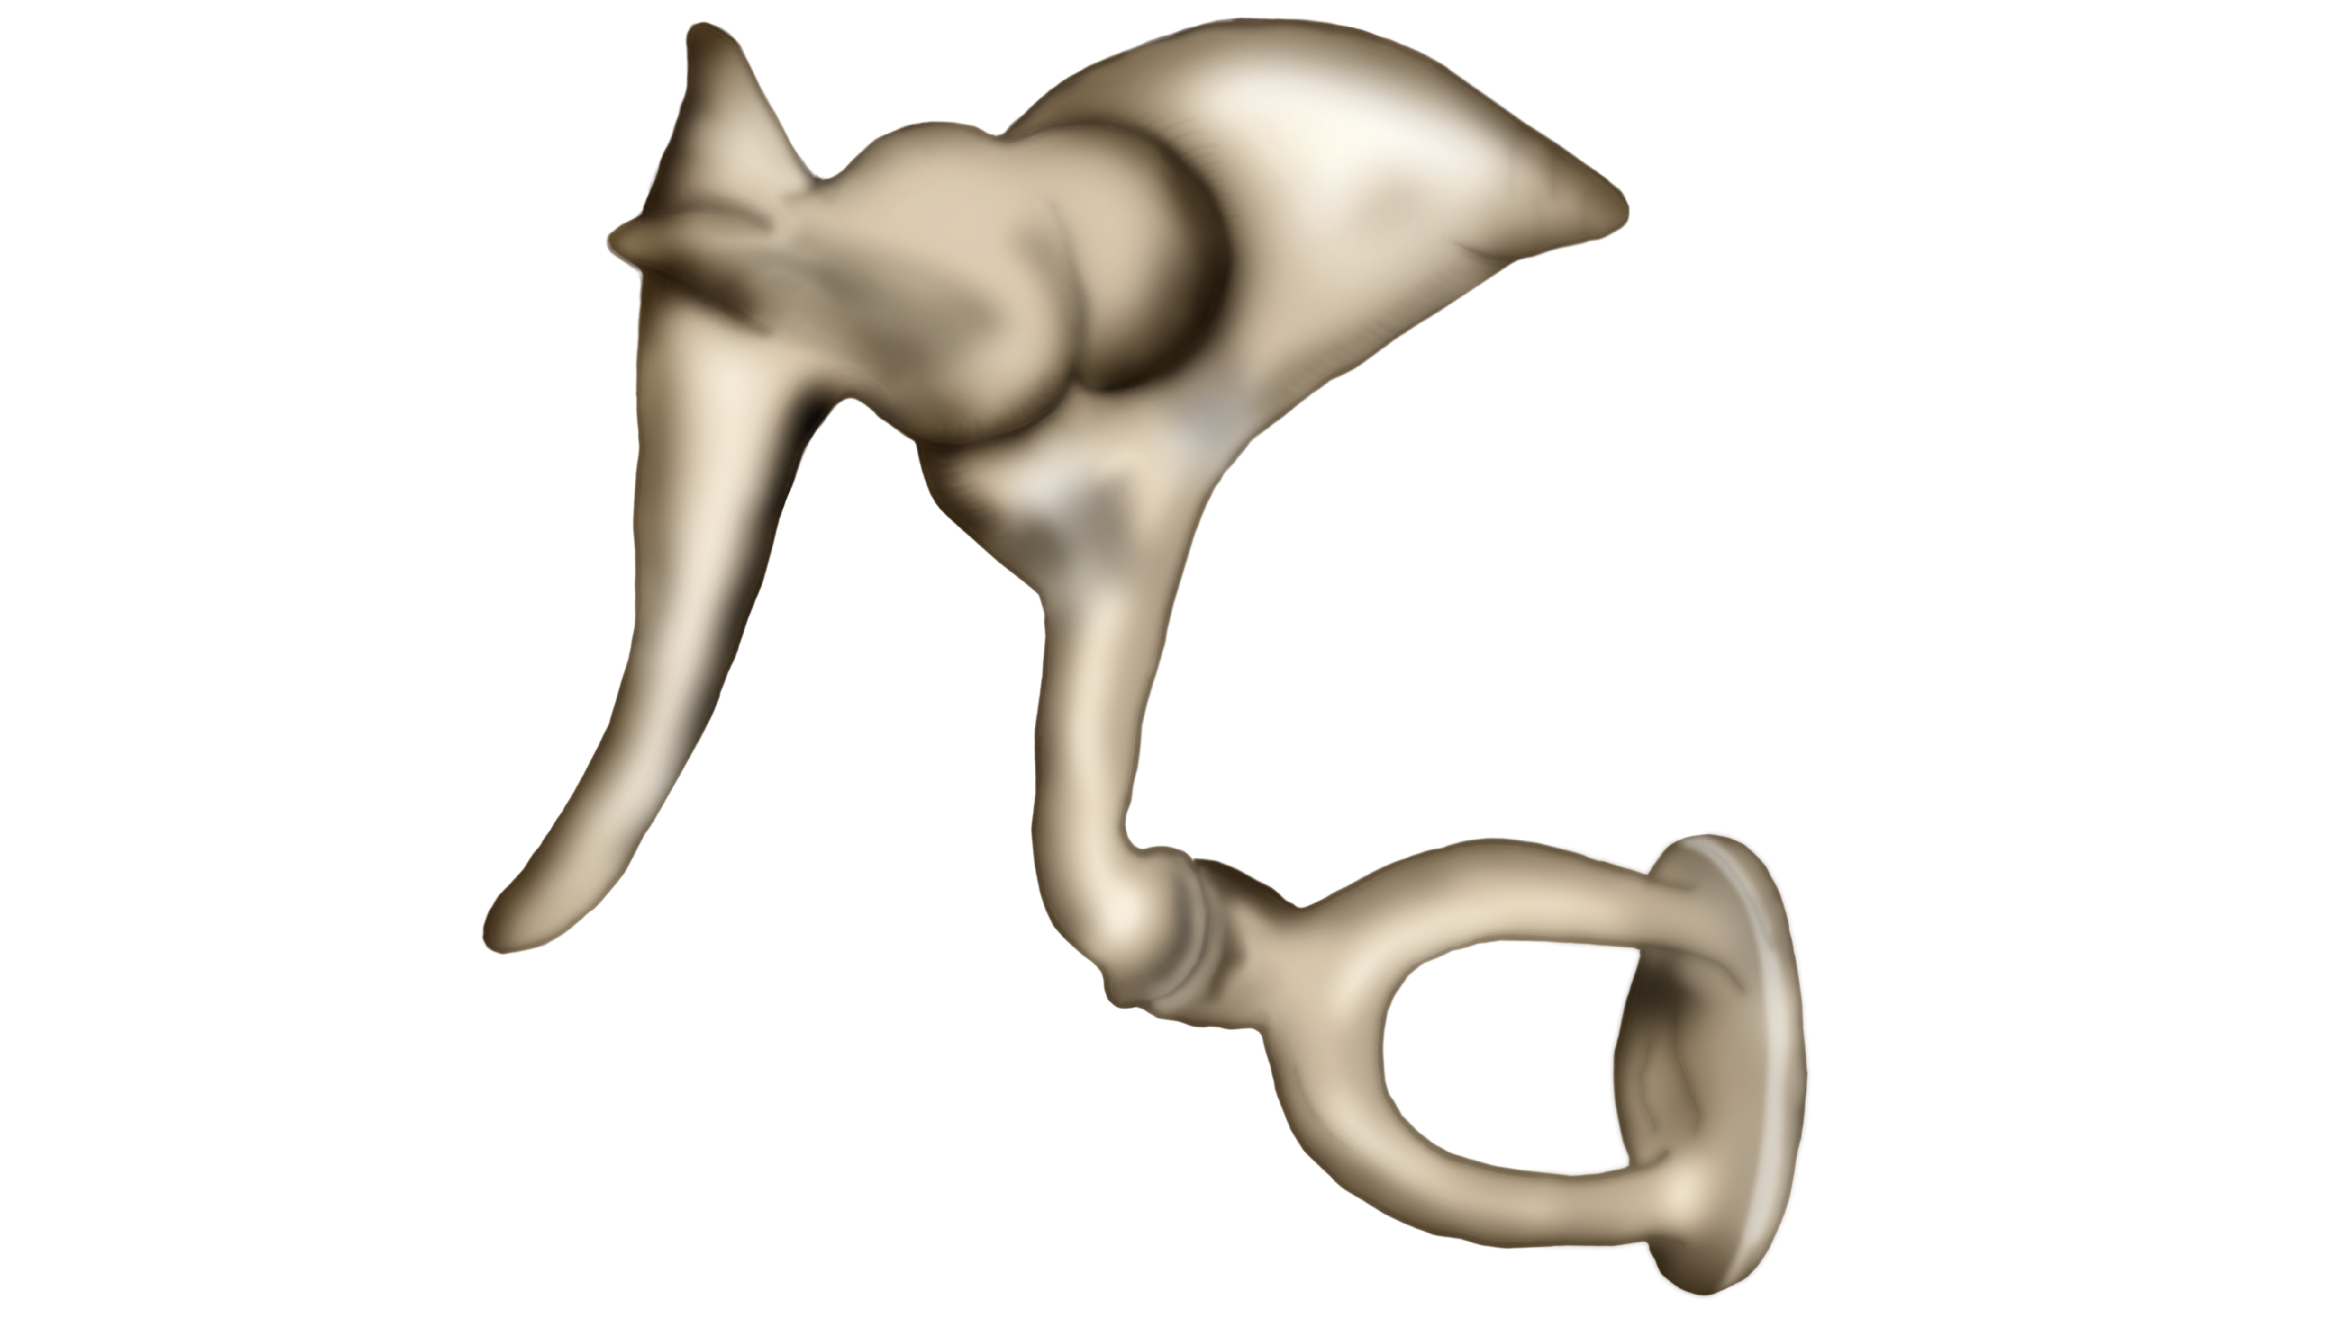

Slide 10
I am… wonderfully made
Genesis 1:26-27: ‘Then God said, “Let us make mankind in our image, in our likeness”… So God created mankind in His own image, in the image of God He created them; male and female He created them.’
Psalm 139:13-14: ‘For you created my inmost being; you knit me together in my mother’s womb. I praise you because I am fearfully and wonderfully made; your works are wonderful, I know that full well.’

Slide 11
When I Stop And Look (AC)

Slide 12
Notes:
Intro to theme: We are all different, but all made by God

Slide 13
I am… wonderfully made
What does this mean for me…?

Slide 15


Slide 16
I am… wonderfully made
Colossians 1:16-17: ‘…all things have been created through Him and for Him. He is before all things, and in Him all things hold together.’

Slide 17
Sing: Who I am (AC)

Slide 18

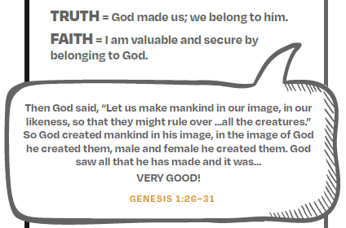

Notes:
God Planned you
He made you
He enjoys what he has made and says ‘very good’ about making you!
How does that make you feel? – write it on a post-it-note

Slide 19
Sing: Who am I (CC)
Notes:
Andy sing whilst writing our Prayers + Church sing as last song

Slide 20
Notes:
Close service

