Slide 1
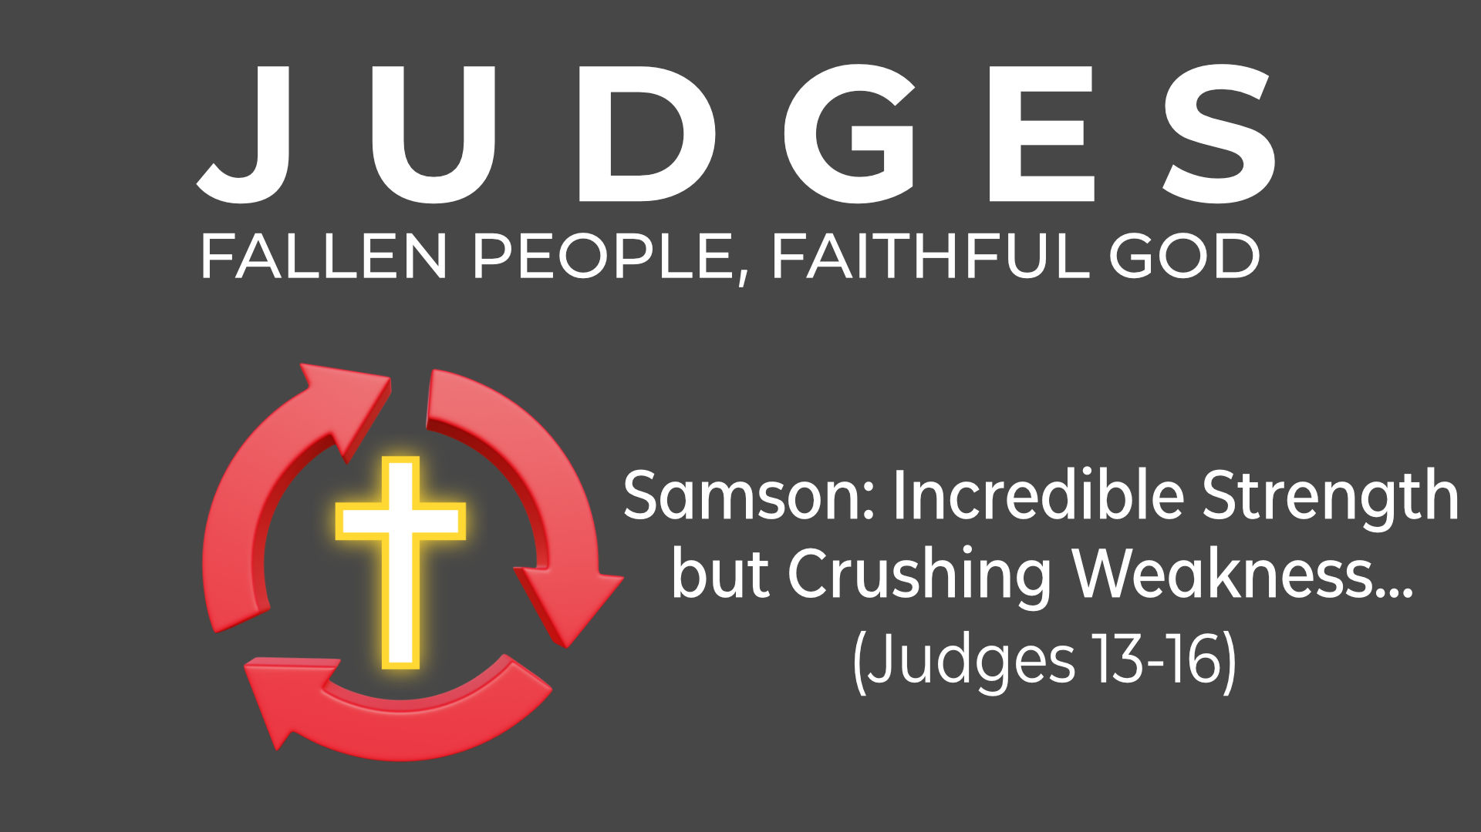

Slide 2


The Cycle of Sin and Deliverance
SIN
PEACE
OPPRESSION
DELIVERANCE
REPENTANCE?

Slide 3
The Cycle of Sin and Deliverance
SIN
PEACE
OPPRESSION
DELIVERANCE
REPENTANCE?

Slide 4
Samson: Incredible Strength but Crushing Weakness… (Judges 13-16)
Four key women in Samson’s life:

Slide 5
Samson: Incredible Strength but Crushing Weakness… (Judges 13-16)
Four key women in Samson’s life:
Mother (Judges 13)

Slide 6
Samson: Incredible Strength but Crushing Weakness… (Judges 13-16)
Four key women in Samson’s life:
Mother (Judges 13)
Wife (Judges 14-15)

Slide 7
Samson: Incredible Strength but Crushing Weakness… (Judges 13-16)
Four key women in Samson’s life:
Mother (Judges 13)
Wife (Judges 14-15)
Prostitute (Judges 16:1-3)

Slide 8
Samson: Incredible Strength but Crushing Weakness… (Judges 13-16)
Four key women in Samson’s life:
Mother (Judges 13)
Wife (Judges 14-15)
Prostitute (Judges 16:1-3)
‘Lover’ (Judges 16:4-31)

Slide 9
Samson: Incredible Strength but Crushing Weakness… (Judges 13-16)
Four key women in Samson’s life:
Mother (Judges 13)
Wife (Judges 14-15)
Prostitute (Judges 16:1-3)
‘Lover’ (Judges 16:4-31)
‘In those days Israel had no king; everyone did as they saw fit’. (Judges 21:25)

