Slide 1

FEAR…
Q. What are you afraid of / what scares you?

Slide 2
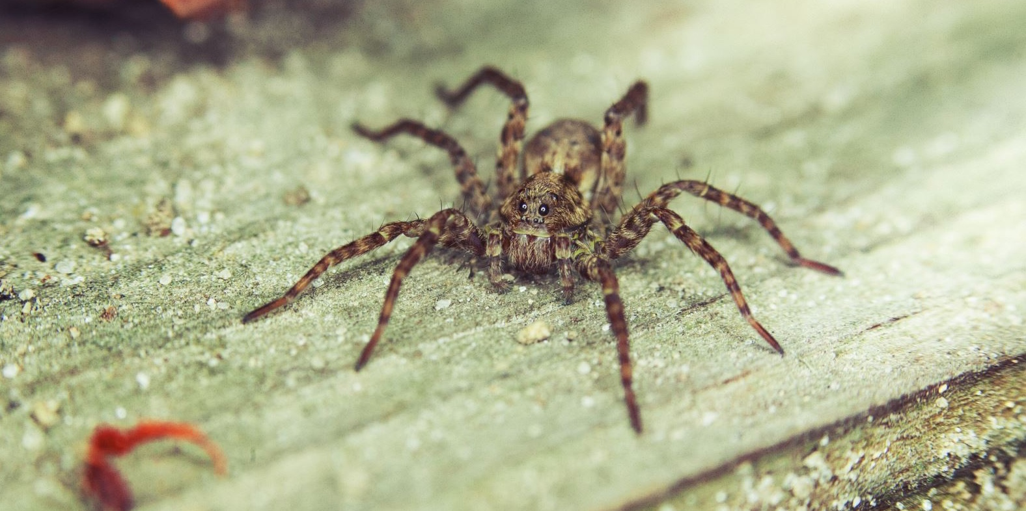
FEAR…

Slide 3

FEAR…

Slide 4
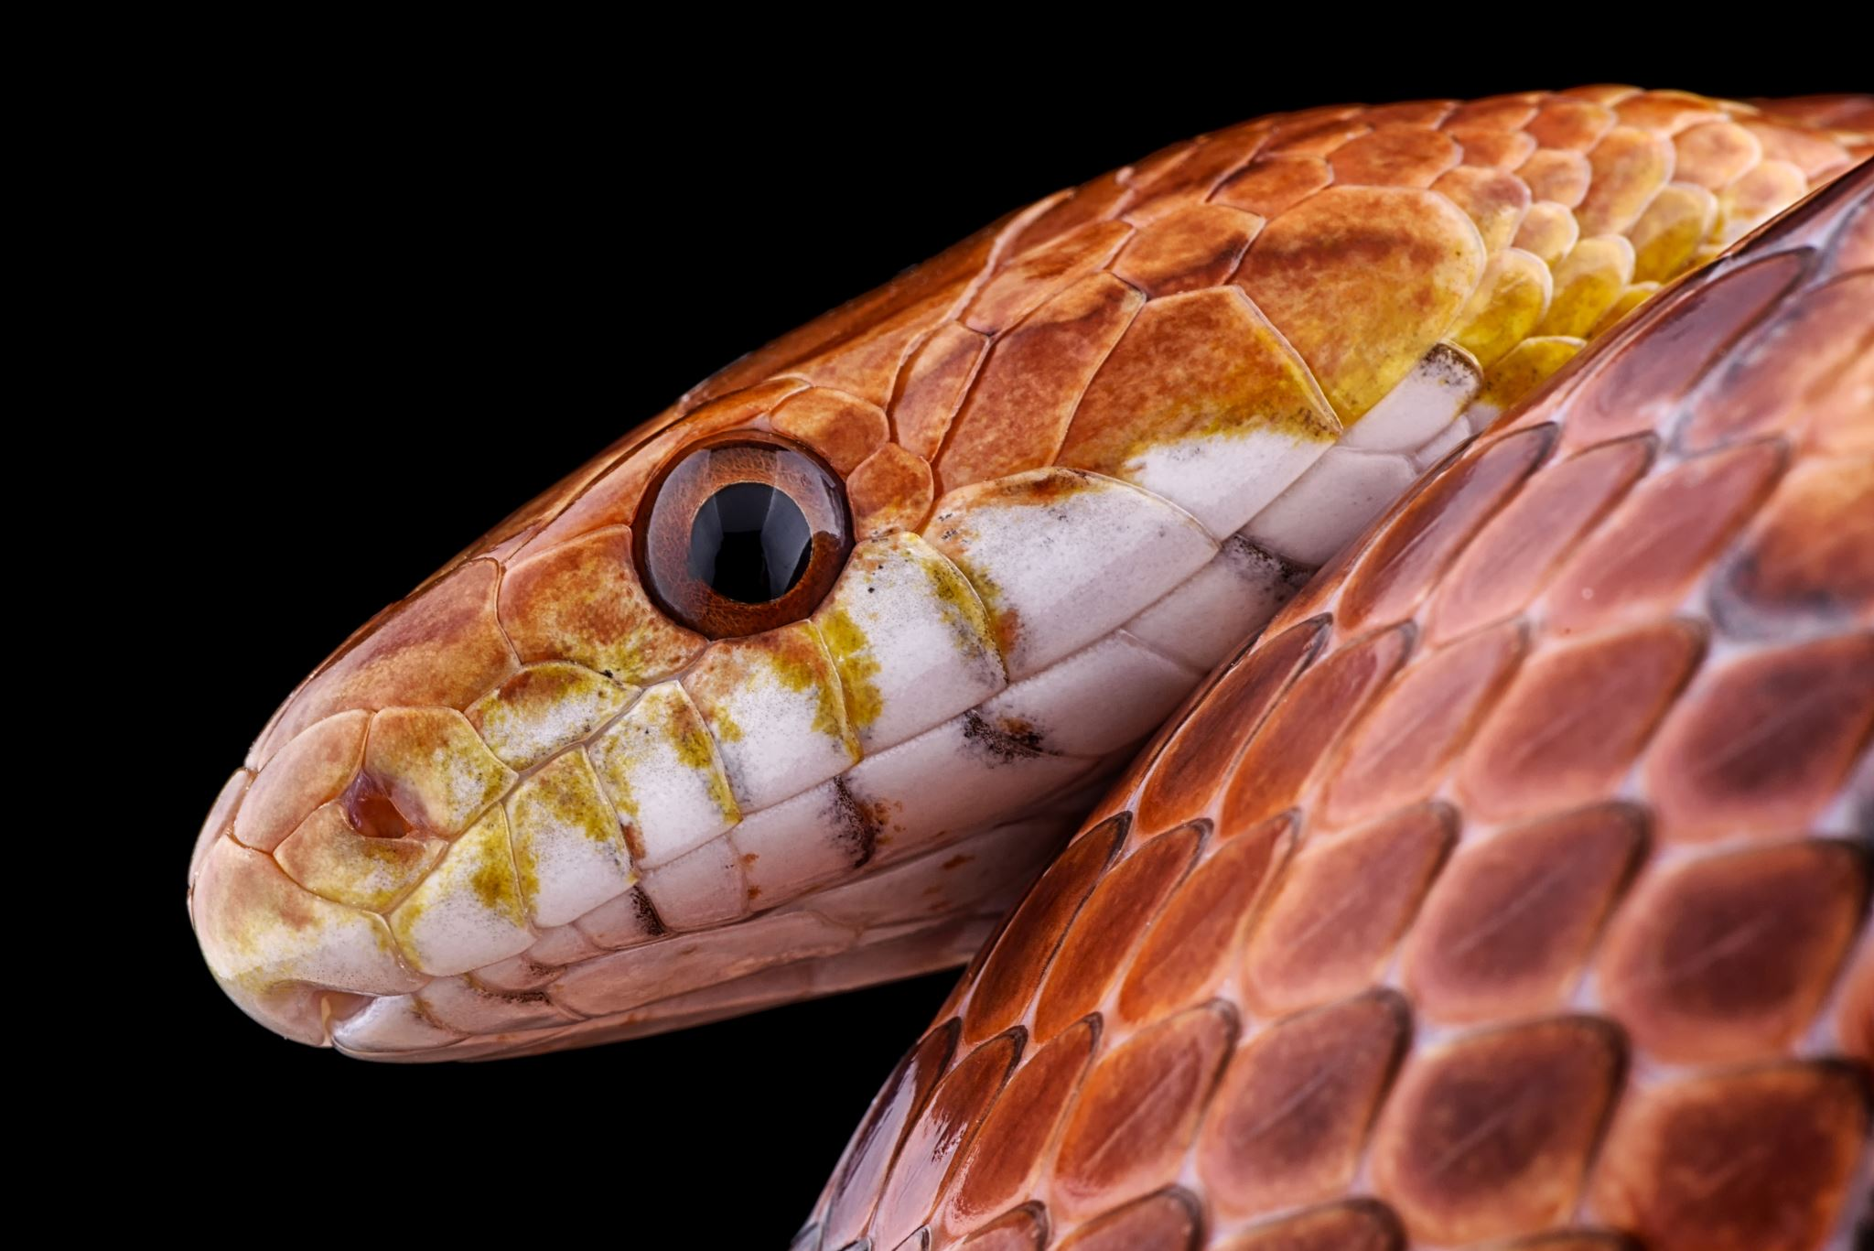
FEAR…

Slide 5

FEAR…

Slide 6

FEAR…

Slide 7

FEAR…

Slide 8
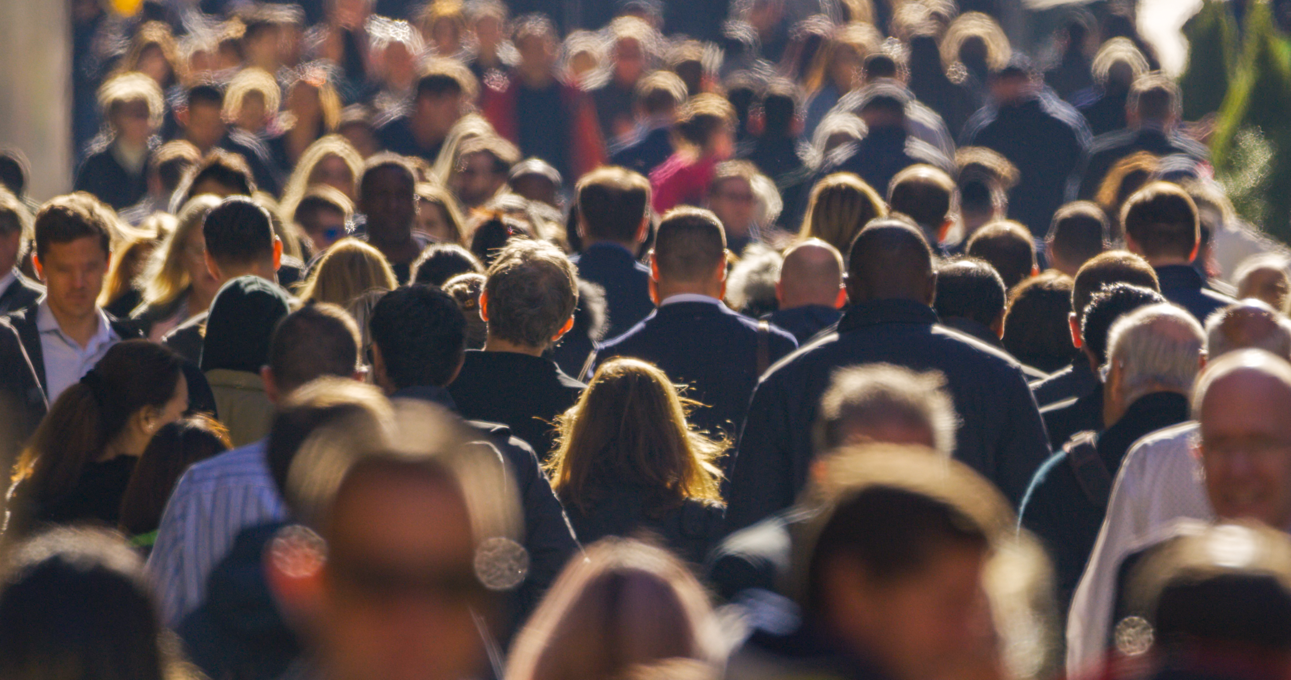
FEAR…

Slide 9

FEAR…

Slide 10
FEAR…
Q. Why are we scared of these?

Slide 11
FEAR…
Q. How can we face our fears?

Slide 12

FEAR…
‘Be bold, be strong,
For the Lord your God is with you!
I am not afraid, I am not dismayed…
For the Lord your God is with you!’

Slide 13


Slide 14

The Cycle of Sin and Deliverance
SIN
PEACE
OPPRESSION
DELIVERANCE
REPENTANCE?

Slide 16
Gideon: Faith or Fear…? (Judges 6-9)
God’s Punishment & Deliverance of Israel (Judges 6-7)

Slide 17
Gideon: Faith or Fear…? (Judges 6-9)
God’s Punishment & Deliverance of Israel (Judges 6-7)
Gideon’s Punishment & Control of Israel (Judges 8:1-28)

Slide 18
Gideon: Faith or Fear…? (Judges 6-9)
God’s Punishment & Deliverance of Israel (Judges 6-7)
Gideon’s Punishment & Control of Israel (Judges 8:1-28)
The Legacy of Gideon (Judges 8:29 – 9:57)

