Slide 1


Slide 2
Bible Reading – Luke 12:49-53

Slide 3


Slide 4


The Great Divider… (Luke 12:49-53)

Slide 5
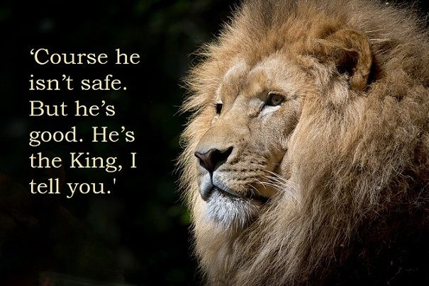
The Great Divider… (Luke 12:49-53)

Slide 6
The Great Divider… (Luke 12:49-53)
Jesus is not ‘safe’… (v49, 51-53)

Slide 7
The Great Divider… (Luke 12:49-53)
Jesus is not ‘safe’… (v49, 51-53)
He is good! (v50)
BUT

Slide 8
The Great Divider… (Luke 12:49-53)
Jesus is not ‘safe’… (v49, 51-53)
He is good! (v50)
Where do you stand…?
BUT

Slide 9
The Great Divider… (Luke 12:49-53)

